Slide 1
Introduction to
Electronics
Lecture 2 : Electrical Circuits
1

Slide 2
Learning Objectives
Distinguish series and parallel resistor connections
Use Kirchhoff's Voltage and Current Laws (KVL, KCL)
Derive and apply the voltage divider and current divider
Understand measurement instruments and their limitations
2

Slide 3
PART 1
Electric Circuits
What circuits are and the quantities that describe them
3

Slide 4
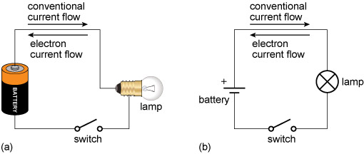
What Is an Electric Circuit?
A complete path for current to flow: source + components + wires
A basic circuit: battery drives current through a lightbulb
Current flows from + terminal, through the load, back to −
Every electronic device is built from circuits
4

Slide 5
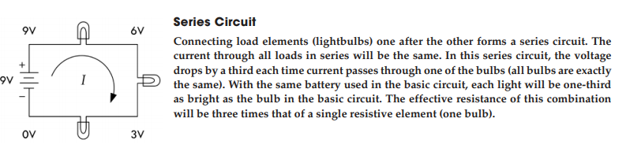
Series Circuits
5

Slide 6
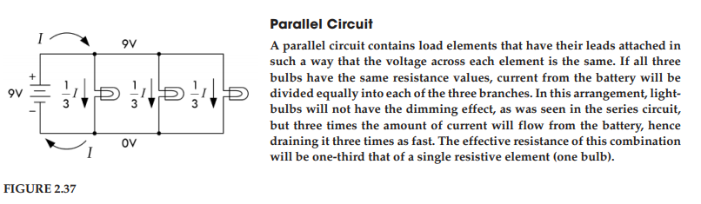
Parallel Circuits
6

Slide 7
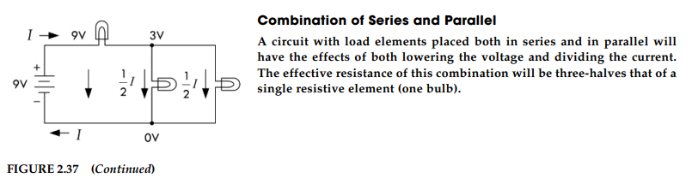
Combination of Series and Parallel
7

Slide 8
Circuit Analysis
How do we predict what the voltages and currents will be in a circuit?
In this lecture, we will learn:
Ohm's Law — relates voltage, current, and resistance
Kirchhoff's Current Law (KCL) — governs current at junctions (parallel circuits)
Kirchhoff's Voltage Law (KVL) — governs voltage around loops (series circuits)
Voltage divider and current divider — shortcuts for common patterns
These tools let us fully analyse any series, parallel, or combination circuit
8

Slide 9
PART 2
Ohm's Law and Resistors
The most fundamental relationship in circuit analysis
9

Slide 10
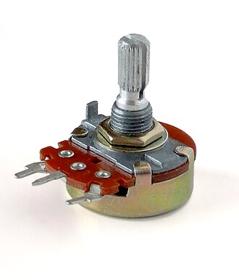
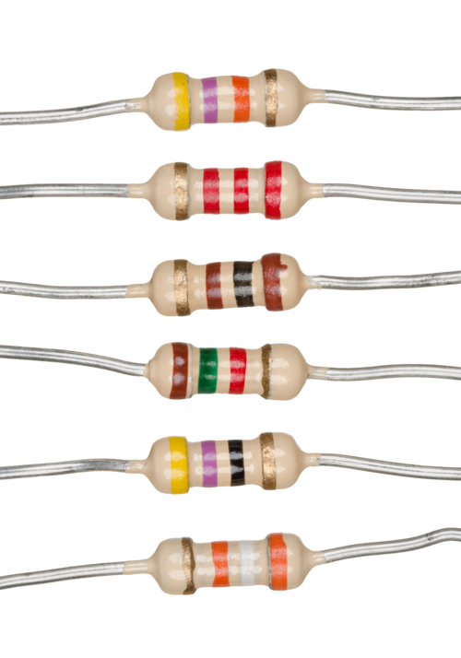
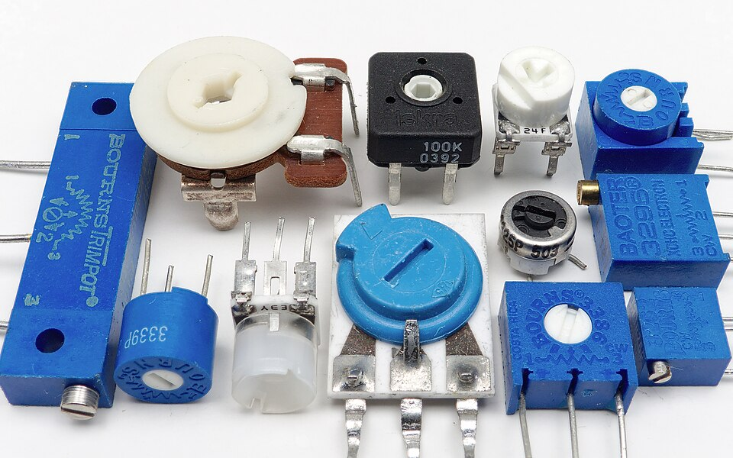
What is a resistor?
Resistors oppose current or set voltage levels within circuits.
Convert electrical energy to heat
10

Slide 11
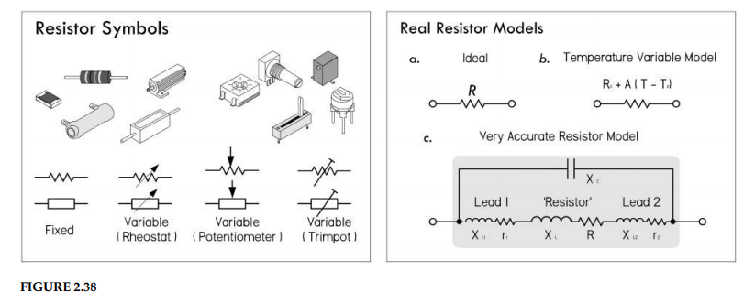
Resistor Symbols, Types, and Models
11

Slide 12
Ohm's Law — The Core Relationship
V = I × R Ohm’s Law
P = VI = V²/R = I²R Ohm’s Power Law
More voltage → more current; More resistance → less current
Ohm's Law is the single most used equation in electronics
R is the resistance or the resistor expressed in ohms (Ω), P is the power loss in watts (W), V is the voltage in volts (V), and I is the current in amperes (A).
12

Slide 13
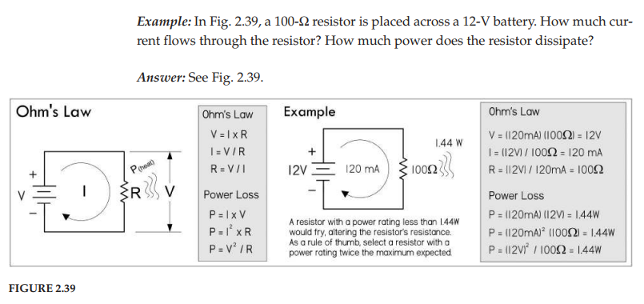
Worked Example — Ohm's Law and Power (Fig. 2.39)
13

Slide 14
Why Power Ratings Matter
Every resistor has a maximum allowable power rating. Exceed it and it fails
Common ratings: 1/8 W, 1/4 W, 1/2 W, 1 W
High- power resistors can range from 2 to several hundred watts
Rule of thumb: use at least twice the expected maximum dissipation
A 25 Ω resistor at 5 V needs > 1 W rating
If you exceed the power rating, you’ll probably end up frying your resistor, destroying the internal structure, and thus altering the resistance
14

Slide 15
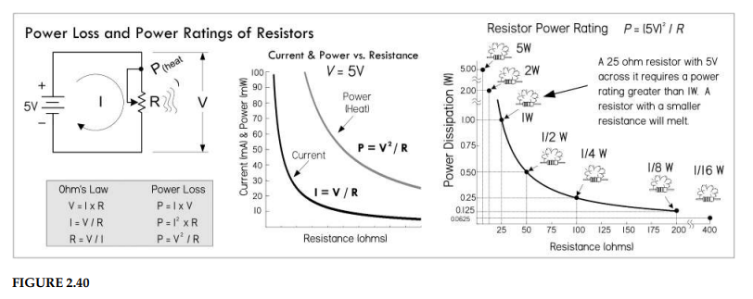
Power Loss and Power Ratings (Fig. 2.40)
15

Slide 16
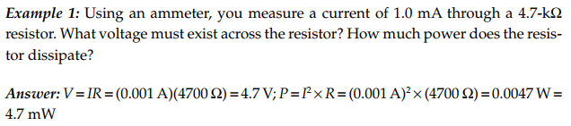
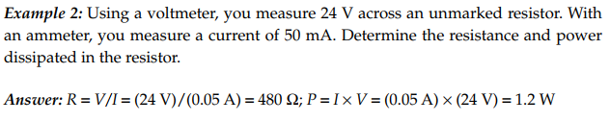
Worked Examples — Ohm's Law Practice
16

Slide 17
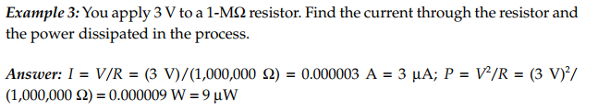
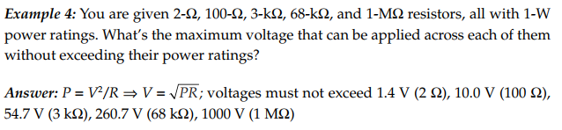
More Practice — Current, Power, and Ratings
17

Slide 18
PART 3
Resistors in Parallel
Same voltage, shared current, lower total resistance
18

Slide 19
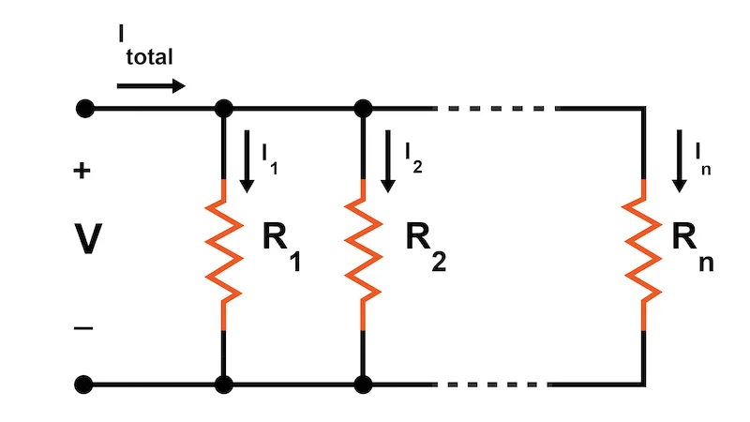
Parallel Connection — Concept
Resistors in parallel share the same two nodes (same voltage across each)
Parallel paths and the current splits
Total resistance is always lower than the smallest individual resistor
19

Slide 20
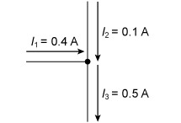
Kirchhoff's Current Law (KCL)
"Sum of currents into a node = sum of currents out“
Conservation of charge
At a junction: I₁ = I₂ + I₃
KCL is the basis for the parallel resistance formula
20

Slide 21
Because all resistor voltages are equal to V_{total} since they share the same voltage across them, we get: I_{total} = V_{total}/R₁ + V_{total}/R₂ + V_{total}/R₃ + …V_{total}/R_{N}
Factoring out V_{total}, we get: I_{total} = V_{total} (1/R₁ + 1/R₂ + 1/R₃ … 1/R₄)
We call the term in brackets R_{total}
Note that there is a shorthand for saying that two resistors are in parallel
The shorthand is to use double bars | | to indicate resistors in parallel. So to say R₁ is in parallel with R₂, you would write R₁ | | R₂
21

Slide 22
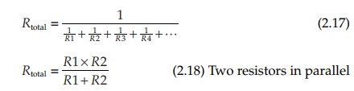
Parallel Resistance Formulas
General: 1/R_total = 1/R₁ + 1/R₂ + 1/R₃ + …
Two resistors: R_total = (R₁ × R₂) / (R₁ + R₂)
N equal resistors: R_total = R / N
Always less than the smallest individual R
22

Slide 23

Thus, you can express two resistors in parallel in the following ways:
In terms of arithmetic order of operation, the | | can be treated similar to multiplication or division
For example, in the equation Z_{in} = R₁ + R₂ | | R_{load}, you calculate R₂ and R_{load} in parallel first, and then you add R₁
23

Slide 24
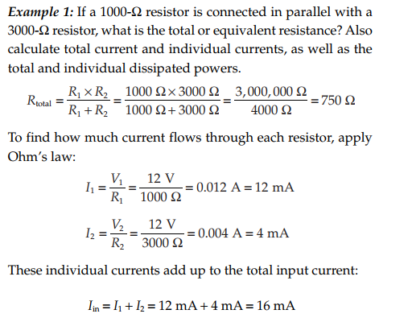
24

Slide 25
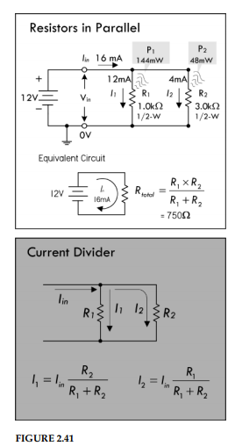
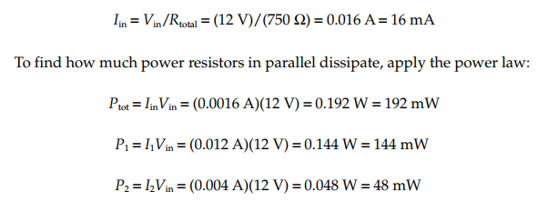
Parallel Circuit — 1 kΩ ∥ 3 kΩ (Fig. 2.41)
25

Slide 26
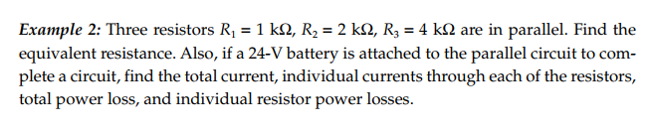
Three-Resistor Parallel — Example 2 (Fig. 2.42)
26

Slide 27
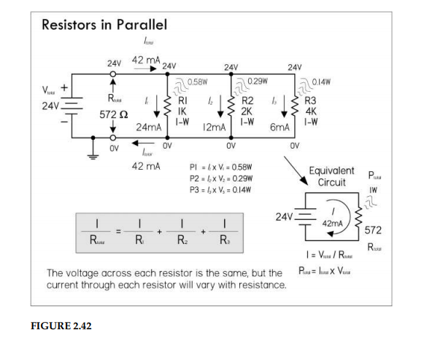
Three-Resistor Parallel — Solution (Fig. 2.42)
27

Slide 28
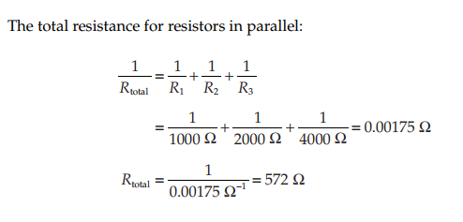
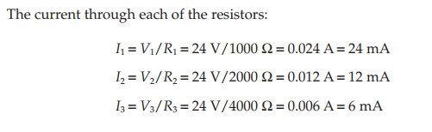
Three-Resistor Parallel — Calculations
28

Slide 29
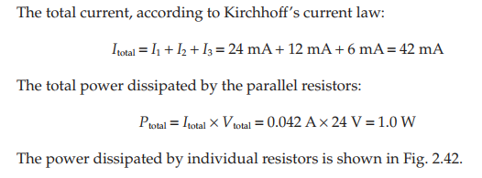
Three-Resistor Parallel — Total Current & Power
29

Slide 30
PART 4
Resistors in Series
Same current, additive voltage drops, and the voltage divider
30

Slide 31
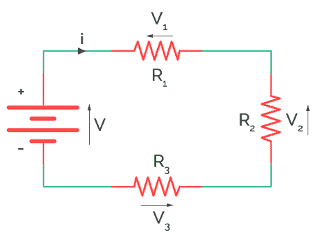
Series Connection — Concept
Same current through every resistor in the chain
Voltage divides: V_total = V₁ + V₂ + V₃ + …
R_total = R₁ + R₂ + R₃ + …
Adding series R always increases total resistance
Larger R → larger voltage drop (V = IR)
31

Slide 32
Kirchhoff's Voltage Law (KVL)
You can derive this formula by noting that the sum of all the voltage drops across each series resistor will equal the applied voltage across the combination V_{total} = V₁ + V₂ + V₃ + … + V_{N}
This is referred to as Kirchhoff’s voltage law
Applying Ohm’s law, and noting that the same current I flows through each resistor, we get: IR_{total} = IR₁ + IR₂ + IR₃ + … + IR_{N}
Canceling the I’s you get: R_{total} = R₁ + R₂ + R₃ + R₄ + …
32

Slide 33
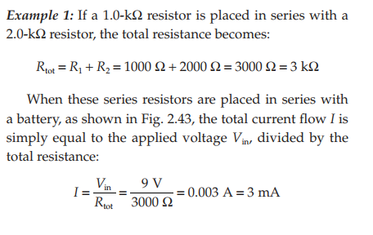
Series Example — 1 kΩ + 2 kΩ (Calculations)
33

Slide 34
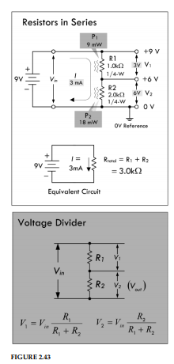
Resistors in Series — Circuit Diagram (Fig. 2.43)
34

Slide 35
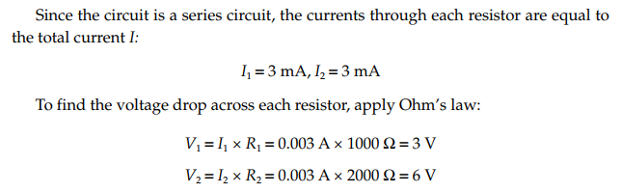
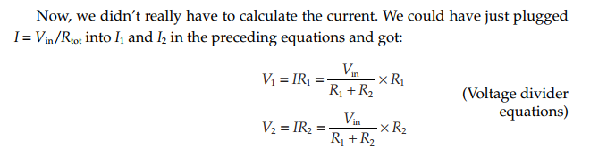
Voltage Drops & Voltage Divider Derivation
35

Slide 36
The Voltage Divider Equation
These equations are called voltage divider equations and are so useful in electronics that it is worth memorizing them. (See Fig. 2.43.)
Often V₂ is called the output voltage V_{out}
The voltage drop across each resistor is directly proportional to the resistance
The voltage drop across the 2000-Ω resistor is twice as large as that of the 1000-Ω resistor
Adding both voltage drops together gives you the applied voltage of 9 V:
36

Slide 37
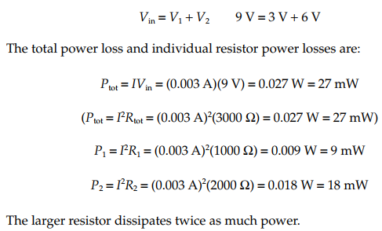
Series — Power Loss in Each Resistor
37

Slide 38
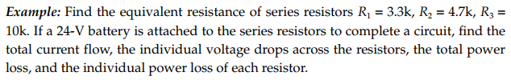
Three-Resistor Series Example (Fig. 2.46)
38

Slide 39
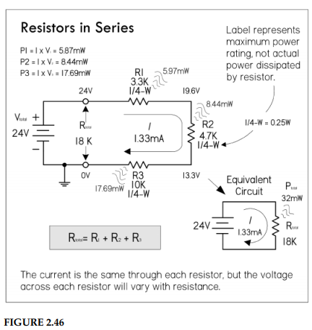
Three-Resistor Series Solution (Fig. 2.46)
39

Slide 40
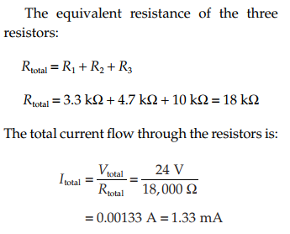
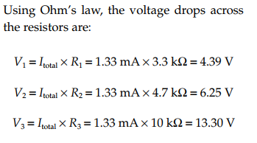
Three-Resistor Series — Calculations
40

Slide 41
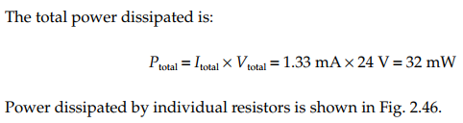
Three-Resistor Series — Total Power
41

Slide 42
PART 5
Measuring Voltage, Current, and Resistance
Ideal instruments vs. real-world limitations
42

Slide 43
Why Measurement Matters
You cannot debug what you cannot measure
Voltmeters, ammeters, and ohmmeters are used to measure voltage, current, and resistance. Ideally it should never introduce any effects within the circuit under test
In theory, an ideal voltmeter should draw no current as it measures a voltage between two points in a circuit; it has infinite input resistance R_{in}
Likewise, an ideal ammeter should introduce no voltage drop when it is placed in series within the circuit; it has zero input resistance
An ideal ohmmeter should provide no additional resistance when making a resistance measurement
43

Slide 44
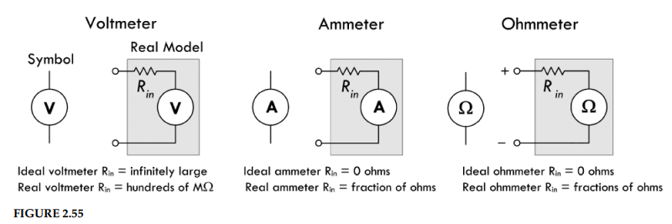
Ideal vs. Real Instruments (Fig. 2.55)
44

Slide 45
Ideal vs. Real Instruments (Fig. 2.55)
An ideal voltmeter has infinite input resistance and draws no current; a real voltmeter’s input resistance is several hundred MΩs
An ideal ammeter has zero input resistance and provides no voltage drop; a real ammeter’s input resistance is fractions of ohms
An ideal ohmmeter has zero internal resistance; a real ohmmeter’s internal resistance is fractions of ohms
It is important to read your instrument manuals to determine the internal resistances.
45

Slide 46
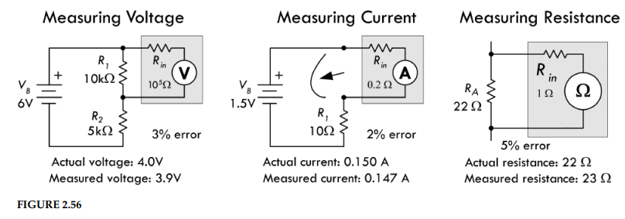
Meter Loading Effects (Fig. 2.56)
46

Slide 47
How a Voltmeter Affects the Circuit
Voltmeter connects in parallel — its input resistance forms a voltage divider
If the resistance in the circuit being measured is far less than the input resistance of the meter, effect is negligible
If the resistance in the circuit being measured is equivalent to the input resistance of the meter, the circuit is loaded
Fig 2.56: 10 kΩ circuit + 100 kΩ meter → 3% error
Modern Digital MultiMeter: 10 MΩ+ input resistance
47

Slide 48
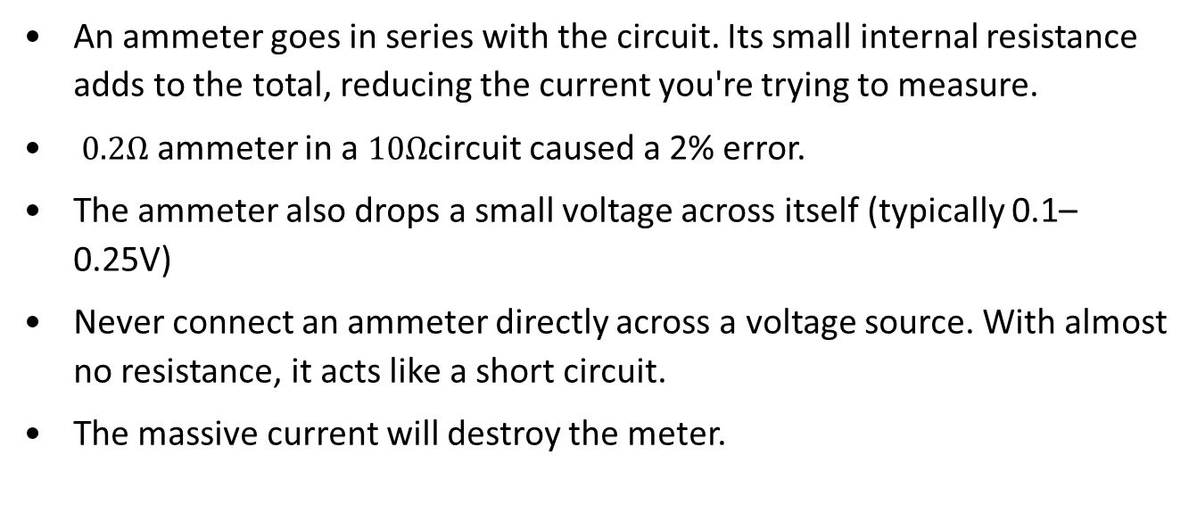
How an Ammeter Affects the Circuit
An ammeter goes in series with the circuit. Its small internal resistance adds to the total, reducing the current you're trying to measure.
$0.2Ω$ ammeter in a $10Ω$circuit caused a 2% error.
The ammeter also drops a small voltage across itself (typically 0.1–0.25V)
Never connect an ammeter directly across a voltage source. With almost no resistance, it acts like a short circuit.
The massive current will destroy the meter.
48

Slide 49
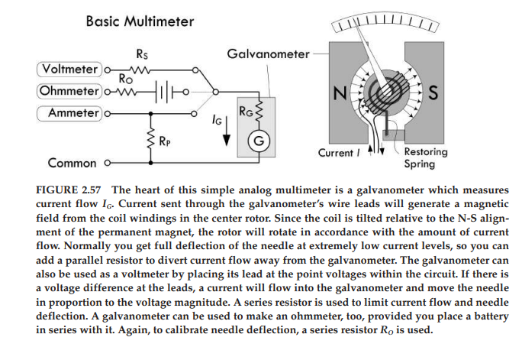
The Multimeter — Internal Structure (Fig. 2.57)
49

Slide 50
End of Lecture
Questions?
50

